Slide 1
Mood.List
A Curation app for Spotify playlists based on user text input

Slide 2
What is Mood.List?
4 billion playlists on Spotify
Takes user input in the form of a snippet of text
Generates a playlist based on keywords and mood
Can save playlists
Email notification when playlists are ready

Slide 3
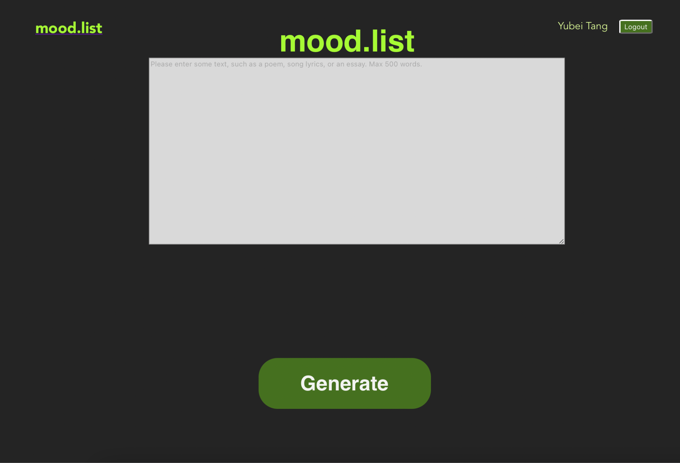
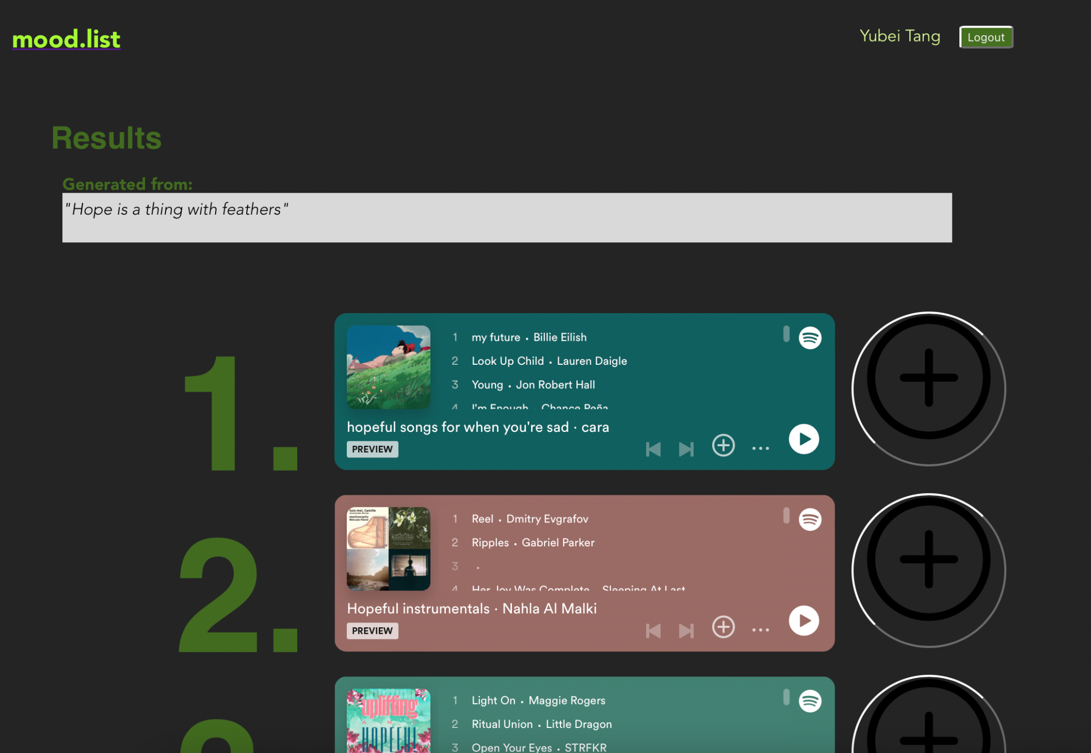
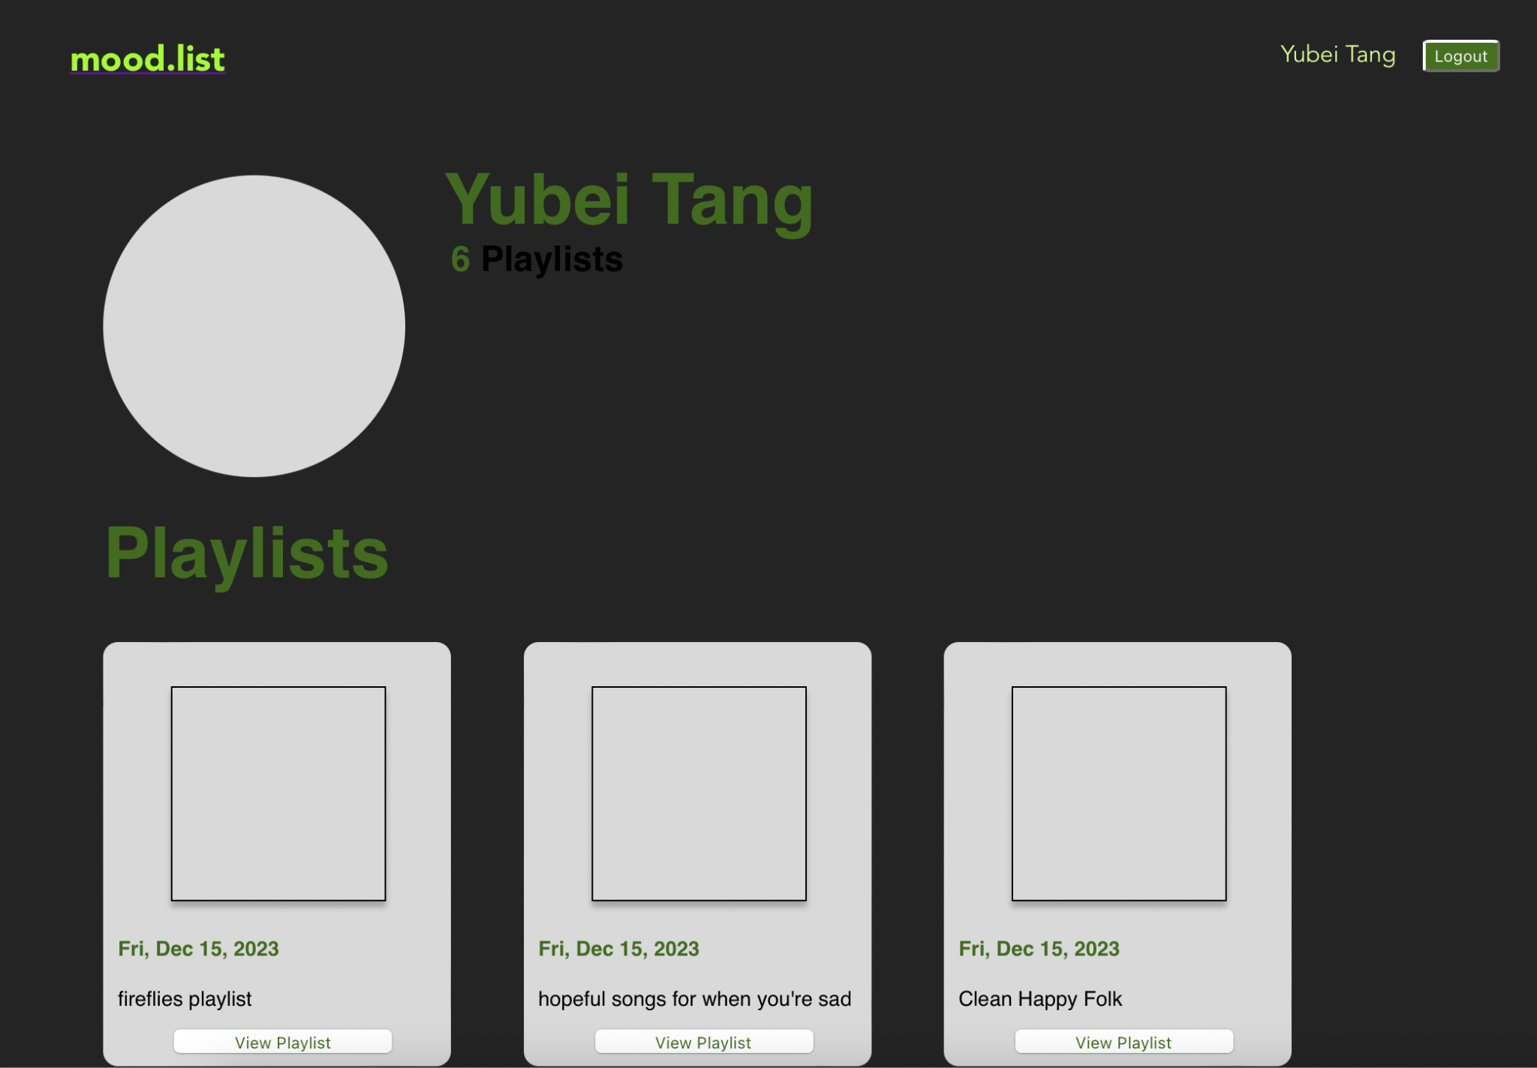
Mood.List: Clockwise: (1) Front page after log-in (2) Playlist results after text is submitted (3) Saved playlists

Slide 4
How Mood.List Finds Playlists
User inputs a piece of text (we recommend 500 words or less, but can be much longer)
Amazon Comprehend processes and compresses text by generating key phrases
Key phrases are sent to OpenAI API to output an emotion like “loneliness” or “inspiration”
Emotion is used as a search term in Spotify to return up to 5 playlists

Slide 5
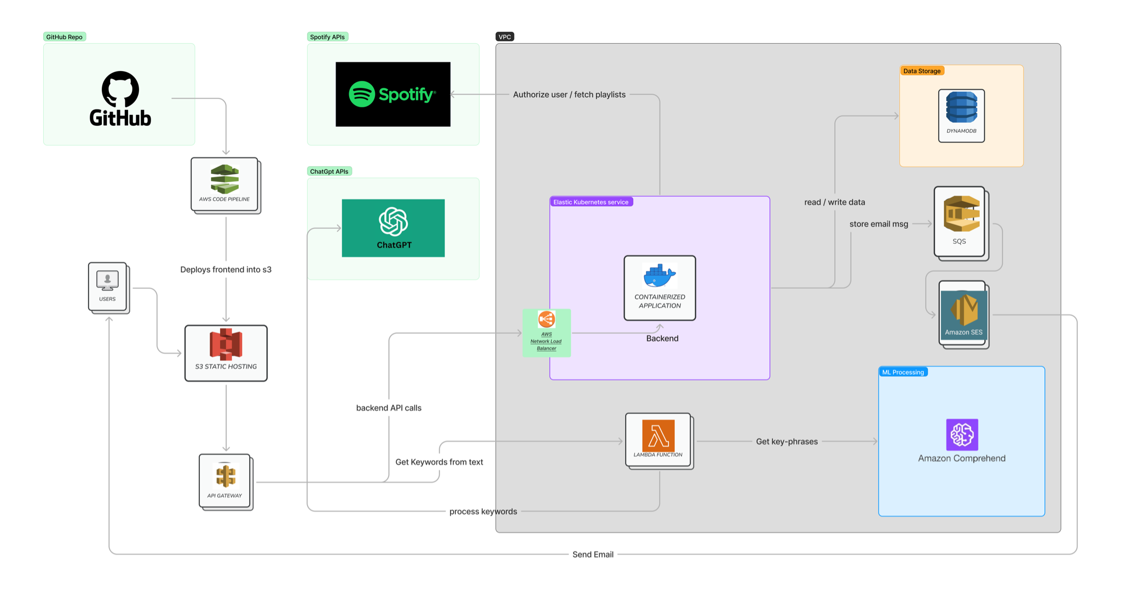
Architecture
Tech Stack:
AWS Services: S3 Buckets, IAM, Lambda, DynamoDB, API Gateway, Simple Queue Service (SQS), EKS (Elastic Kubernetes Service), Amazon Comprehend, SES, Amazon Load Balancing
Other: Spotify API, Python, Docker, HTML/CSS, Javascript (React, NodeJS), OpenAI API

Slide 6
Tech Highlights
AWS network load balancer distributes client requests
Kube secrets to store our sensitive information like API credentials and database keys
Kubernetes cluster of 2 t4g.medium nodes
DynamoDB stores two tables: users and playlists
Integration with Spotify API to handle user authentication and playlist search
Integration with OpenAI API to generalize text as emotions

Slide 7
Challenges
Costs: Not too bad, but when we tried Sagemaker (not used ultimately) we incurred some costs because our instance needed a GPU, which charges per hour. This is not sustainable in the long run, unless our app starts making money.
Latency: Originally, we had more lambda functions, but hosting a lot of our NLP/keyword extraction in Lambda led to long lag times. So we switched to Amazon Comprehend
Integrations: Integrating AWS Network Load Balancer with API Gateway meant we had to expose our back-end, an AWS-specific issue

Slide 8
Changes to Proposal
Originally proposed 2 neural networks to extract keywords and classify emotions
Wanted to deploy ML models using Sagemaker
Realized this was overkill: short snippets of text are not suitable for keyword extraction and existing technology to classify emotions are not fine-tuned for nuanced emotions like “loneliness”
Sagemaker is costly if you need an instance with a GPU
Difficult to deploy custom MLs

Slide 9
Further Work
Set up a central monitoring dashboard where we can view logs of pods running inside a Kubernetes cluster for more convenient access
More user features, such as generating playlists, taking into account user’s tastes and song history, and showing community results
More sophisticated ways of matching songs to text

